Slide 1

推荐系统论文分享
Study
REPORT
2021
杨舒文
2021/4/8

Slide 2
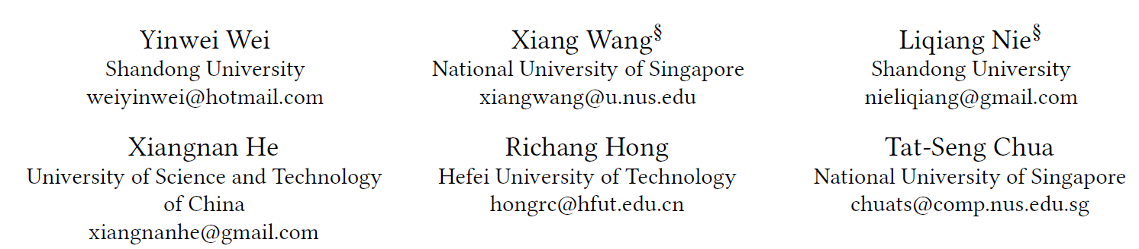
MMGCN: Multi-modal Graph Convolution Network for
Personalized Recommendation of Micro-video
Wei Y, Wang X, Nie L, et al. MMGCN: Multi-modal graph convolution network for personalized recommendation of micro-video[C]//Proceedings of the 27th ACM International Conference on Multimedia. 2019: 1437-1445.

Slide 3
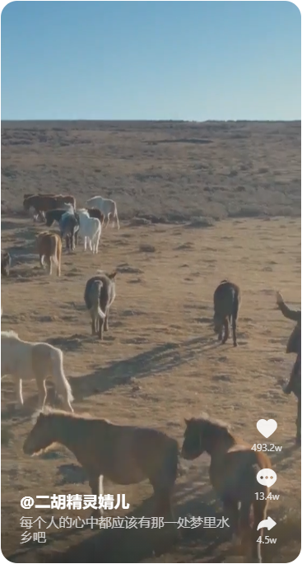

Background
Acoustic
短视频推荐
Video frames
User
点赞、评论、转发
Descriptions
Micro-video
Notes:
对于微视频推荐，我们除了考虑user与item之间的交互外，还需要考虑如何将item本身固有的三种模态特征信息融入到推荐系统中，提高推荐系统性能

Slide 4
Overview
Motivation
Method
Experiments
Conclusion

Slide 5
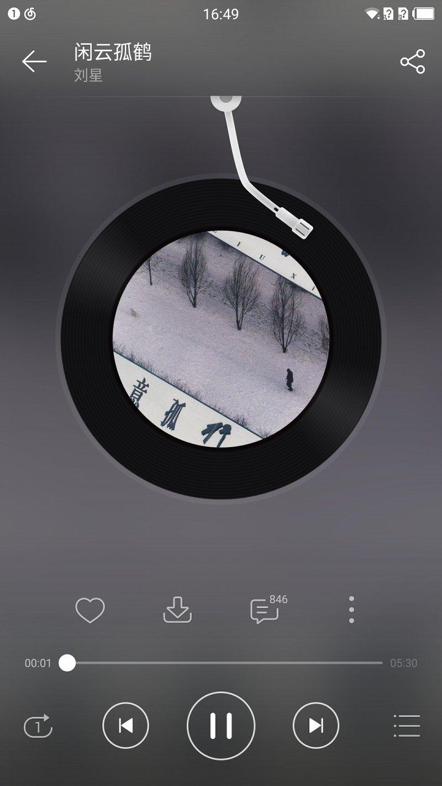
Motivation
Acoustic
Acoustic
Video frames
Descriptions
Micro-video
Distinct from these item contents (e.g., image, music) that are solely from a single modality, microvideos contain rich multimedia information — frames, sound tracks, and descriptions

Slide 6
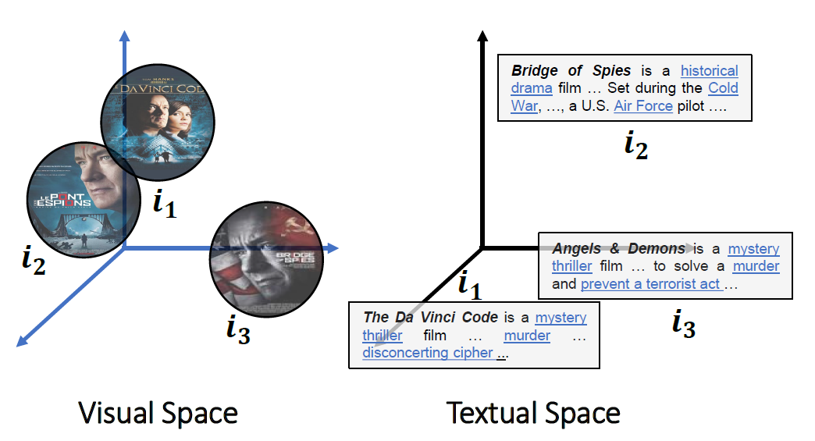
Motivation
Incorporating such multi-modal information into historical interactions between users and micro-videos help establish an in depth understanding of user preferences:
There is a semantic gap between different modalities.

Slide 7
Motivation
Incorporating such multi-modal information into historical interactions between users and micro-videos help establish an indepth understanding of user preferences:
There is a semantic gap between different modalities.
A user may have different tastes on modalities of a micro-video.

Slide 8
Overview
Motivation
Method
Experiments
Conclusion

Slide 9
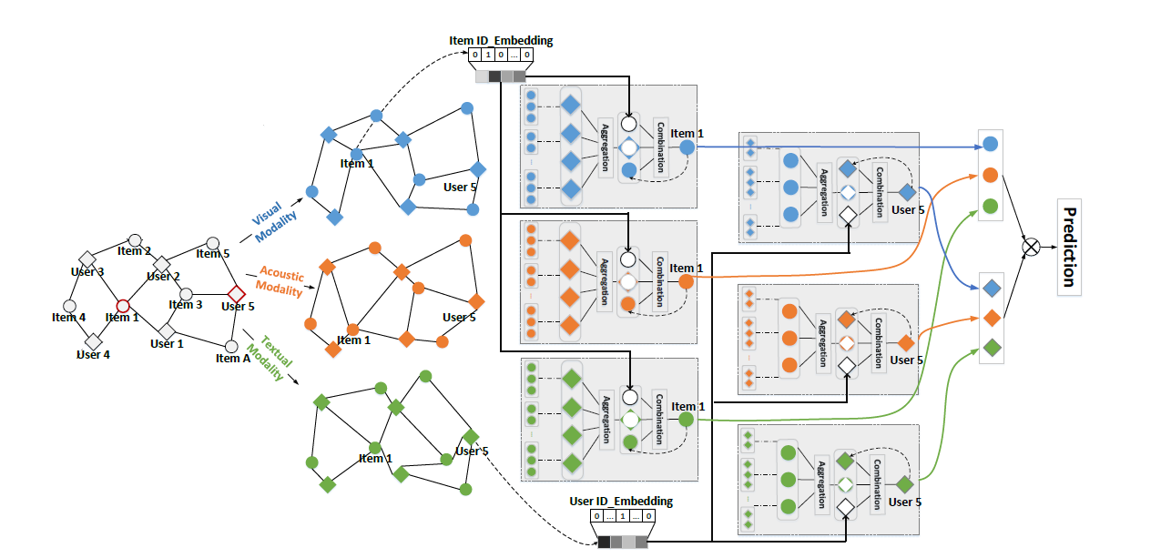
Model - Overview
Notes:
整个模型分为3条线路

Slide 10
Model - Overview
Notes:
整个模型分为3条线路

Slide 11
Model - Overview
Notes:
整个模型分为3条线路

Slide 12
Model - Overview
Notes:
整个模型分为3条线路

Slide 13
Model - Overview
Notes:
整个模型分为3条线路

Slide 14
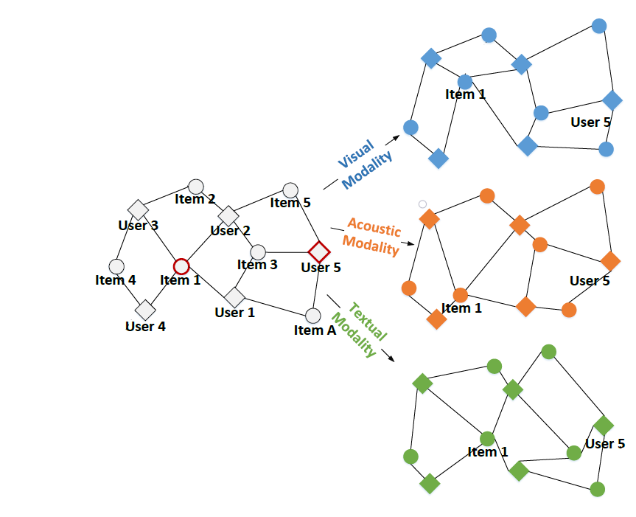

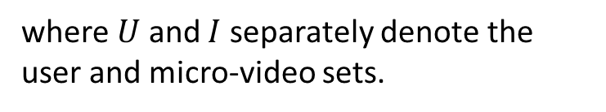
Model
Modality-aware User-Item Graphs
Represent the interaction data as a bipartite user-item graph
where $U$ and $I$ separately denote the user and micro-video sets.

Slide 15
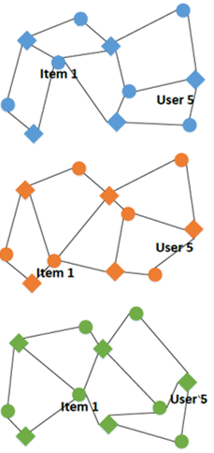
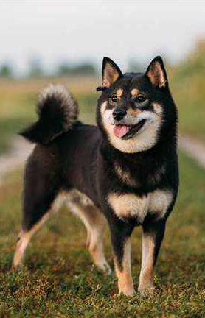


Model
Feature extraction
CNN
Key frames
Visual features
Visual
VGGish
Audio tracks
Acoustic features
Acoustic
Sentence2Vector
Text info.
textual features
Textual
Notes:
不同模态的 user-item 图区别

Slide 16
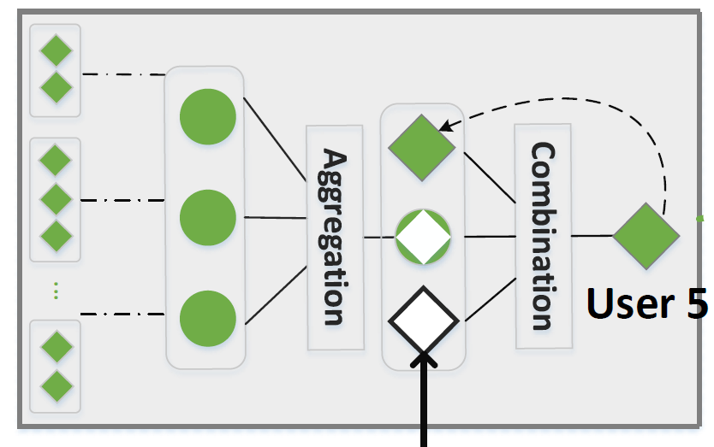
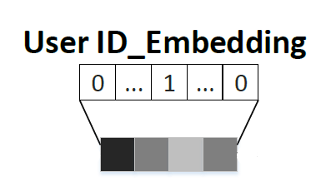
Model
Multi-model GCN
The Multi-model GCN consists of two components:
Aggregation layer
Combination layer

Slide 17

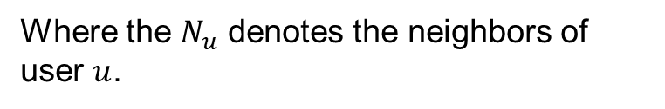
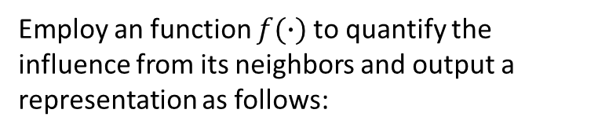
Model
Aggregation layer
Employ an function $f(∙)$to quantify the influence from its neighbors and output a representation as follows:
Where the $N_{u}$ denotes the neighbors of user $u$.

Slide 18


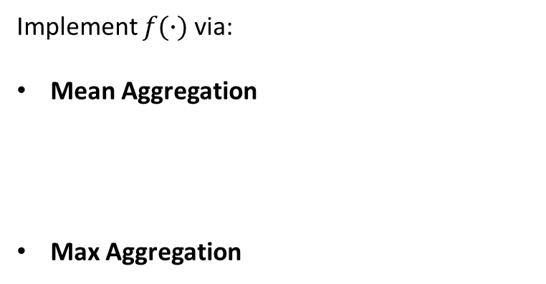
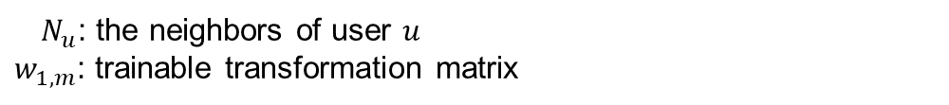
Model
Aggregation layer
Implement $f(∙)$via:
Mean Aggregation
Max Aggregation
$N_{u}$: the neighbors of user $u$
$w_{1,m}$: trainable transformation matrix
Notes:
平均聚合里每一个邻居所作的贡献都是相同的，而最大聚合每个邻居的贡献则不一样

Slide 19

Model
Combination layer
Update the user's representation in modal $m$:
$u_{id}$: User’s ID Embedding

Slide 20
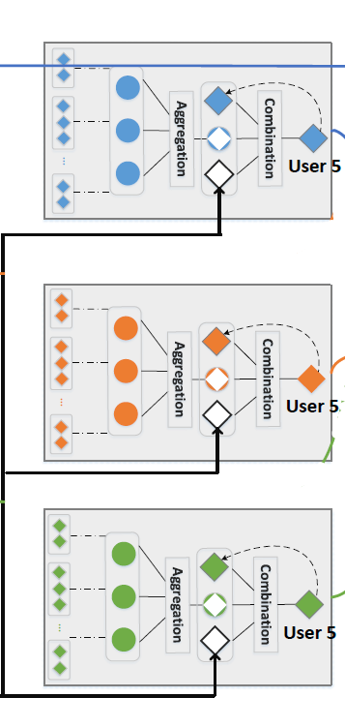

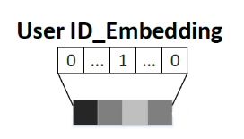
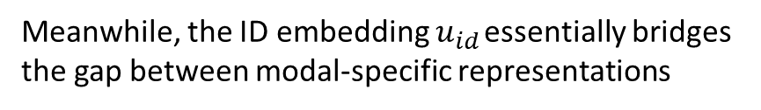
Model
Combination layer
Meanwhile, the ID embedding $u_{id}$ essentially bridges the gap between modal-specific representations
$w_{2,m}$: trainable transformation matrix
Notes:
u

Slide 21


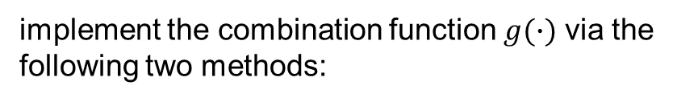
Model
Combination layer
implement the combination function $g(∙)$ via the following two methods:
Concatenation Combination
Element-wise Combination
$w_{2,m}$, $w_{3,m}$: trainable transformation matrix
Notes:
u

Slide 22

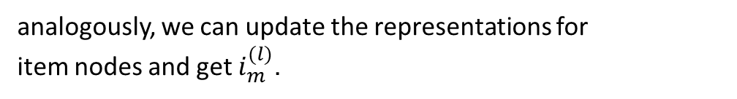
Model
Model Prediction
Formally, the representation from l-hop neighbors of user u and the output of l-th multi-modal combination layer are recursively formulated as:
analogously, we can update the representations for
item nodes and get $i_{m}^{(l)}$.
Notes:
u

Slide 23
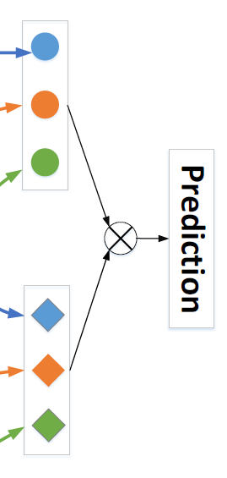
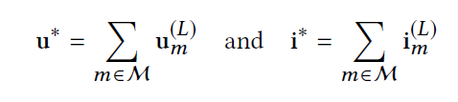
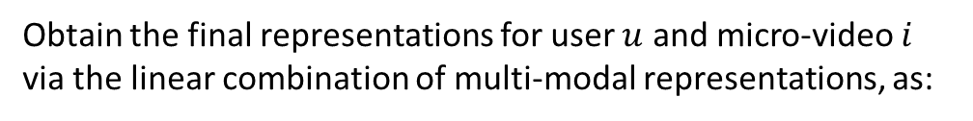
Model
Model Prediction
Obtain the final representations for user $u$ and micro-video $i$ via the linear combination of multi-modal representations, as:
Notes:
u

Slide 24


Optimization
loss – Bayesian Personalized Ranking
sigmoid function
Notes:
u

Slide 25
Overview
Motivation
Method
Experiments
Conclusion

Slide 26
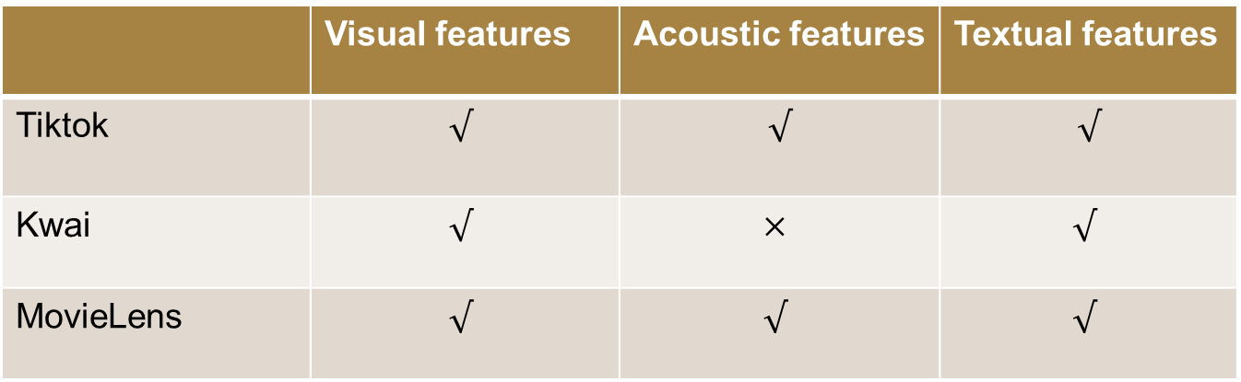
Experiment
Dataset
 | Visual features | Acoustic features | Textual features
Tiktok | $$√$$ | $$√$$ | $$√$$
Kwai | $$√$$ | $$×$$ | $$√$$
MovieLens | $$√$$ | $$√$$ | $$√$$

Slide 27
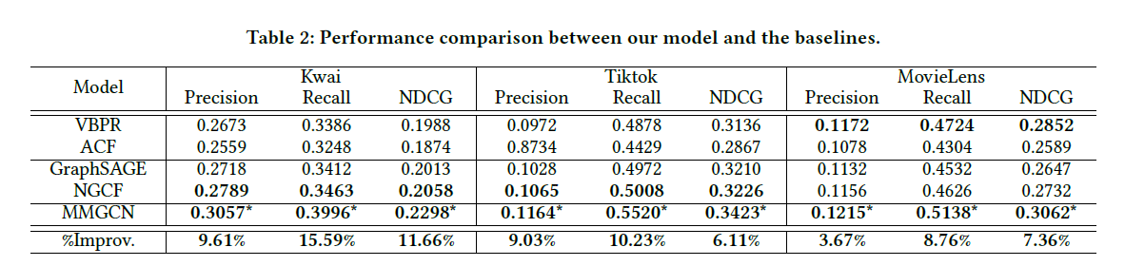
Experiment

Slide 28
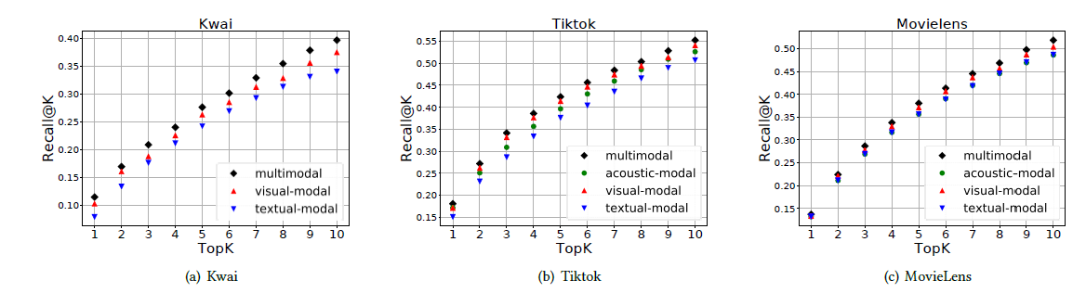
Experiment

Slide 29
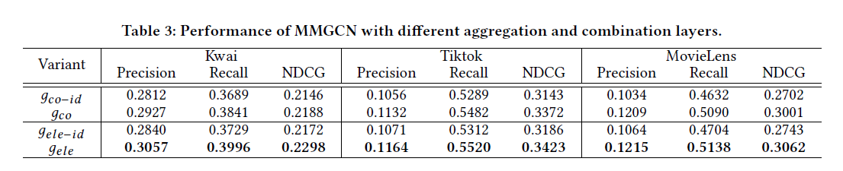
Experiment

Slide 30
Overview
Motivation
Method
Experiments
Conclusion

Slide 31
Conclusion
Summary
propose a novel GCN-based framework to Personalized Recommendation of Micro-video
Shortcomings
No consideration of interaction type
Notes:
No consideration of interaction type

Slide 32
Thanks

